Slide 1


CVCS Escapement Modeling
Introduction and Theory of Mark-Recapture Models
Presented by:
Arthur Barros, California Department of Fish and Wildlife
Arthur.Barros@wildlife.ca.gov

Slide 2
Workshop outline
9:00 AM - 10:00 AM: Introduction and Theory of Mark-Recapture
10:00 AM - 10:15 AM: Morning Break
10:15 AM - 12:00 PM: The Mathematics of CVCS Escapement
12:00 PM - 1:00 PM: Lunch Break (on your own)
1:00 PM - 2:30 PM: Coding the Model
2:45 PM - 4:00 PM: Testing the Model
4:00 PM – 4:30 PM: Model Feedback and Discussion
4:30 PM - Workshop End

Slide 3
Workshop purpose
Translate and clarify the Central Valley Chinook Salmon (CVCS) escapement model.
The escapeMR application and model developed by Trent McDonald, Ph.D. in 2020.
The model has been used by scientists and escapement surveyors to produce annual escapement estimates.
Despite the model's utility, it has acted as a “black-box”.
If users understand the model, they can better assess how methods changes impact abundance estimates.
?
Survey data in
Abundance estimates out

Slide 4
Workshop purpose
Provide users the knowledge to make decisions on future of escapement modeling methods.
Possibly pivot away from escapeMR build.
Adopting R optim() based optimization algorithm.
Incorporating additional capture and survival covariates for more complex models.

Slide 5
Workshop purpose
Build a repository of escapement modeling details and methods that scientists can utilize going forward.
A central repository accessible across agencies that can be pulled from and built upon.
Documentation of math, methods, and code used in the model.

Slide 6

Workshop GitHub
https://github.com/arthurbarros-CDFW/CVCS-Modeling-workshop

Slide 7

Who I am
Arthur Barros
Arthur.Barros@wildlife.ca.gov
Biostatistician for Fisheries Branch
Research Data Specialist II
Experience
Environmental Scientist, Zooplankton Study R3
Staff Research Associate / Grad-student, UC Davis
Education
Masters in Ecology, UC Davis
Bachelors in Conservation Biology, UC Davis
Publications
Barros, A., Hartman, R., Bashevkin, S. M., & Burdi, C. E. (2024). Years of Drought and Salt: Decreasing Flows Determine the Distribution of Zooplankton Resources in the San Francisco Estuary. San Francisco Estuary and Watershed Science, 22(1), 1–20. https://doi.org/10.15447/sfews.2024v22iss1art3
Barros, A., Hobbs, J. A., Willmes, M., Parker, C. M., Bisson, M., Fangue, N. A., ... & Lewis, L. S. (2022). Spatial Heterogeneity in Prey Availability, Feeding Success, and Dietary Selectivity for the Threatened Longfin Smelt. Estuaries and Coasts, 1-14.

Slide 8
What to expect
Statistics
Probability and likelihood
Logarithms
Data distributions
Linear regression
Maximum likelihood estimation *
Boot-strapping *
R coding
Functions
For loops
Plotting
Please feel free to interrupt and ask questions!

Slide 9

R packages used
tidyverse (https://www.tidyverse.org/)
ggplot2
dplyr
escapeMR (https://gitlab.com/tmcd/escapemr)
mra
Rcpp (https://cran.r-project.org/web/packages/Rcpp/index.html)

Slide 10
An introduction to mark-recapture models
Common method for estimating size of a population without needing to observe all individuals.
Involves marking periods, mixing periods, and recapture periods.
CVCS Mark-Recapture Surveys
Carcasses marked with disc-tags.
Multiple mark-recapture periods covering the escapement period.

Slide 11
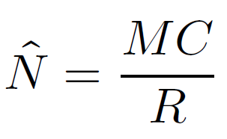


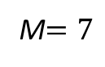

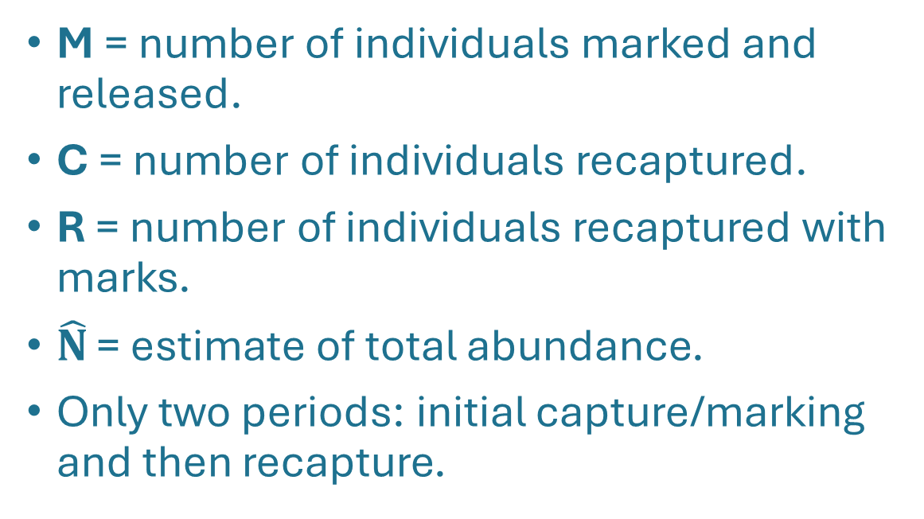
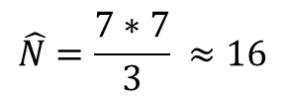
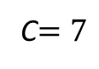
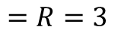
MR: Lincoln-Petersen
M = number of individuals marked and released.
C = number of individuals recaptured.
R = number of individuals recaptured with marks.
$\hat{N}$ = estimate of total abundance.
Only two periods: initial capture/marking and then recapture.
M$=7$
#
$$=R=3$$
C$=7$
$$\hat{N}=\frac{7∗7}{3} ≈16$$
$$N=15$$
Frederick C. Lincoln. Calculating Waterfowl Abundance on the Basis of Banding Returns. Tech. rep. US Department of Agriculture, 1930. arXiv: arXiv:1011.1669v3.
C. G. J. Petersen. “The yearly immigration of young plaice in the Limfjord from the German sea”. In: Report of the Danish Biological Station 6 (1896), pp. 5–84.
Notes:
Before we dive into the current method for modeling our escapement estimates, I wanted to highlight a couple of historical methods that use mark-recapture data to estimate abundance in a population. It’s important to see the base of mark-recapture models, to then understand why we use our current methods.
The classic mark-recapture estimator is known as a Lincoln-Peterson, which uses an initial marking period in which fish in the population are captured and marked (K), followed by a single recapture period, in which fish are captured (n) and the number of marked fish is counted (k). We can then estimate the abundance of fish in the population as a ratio between the number of fish caught in the recapture period multiplied by the number of fish marked initially, divided by the number of marked fish in the recapture period.

Slide 12
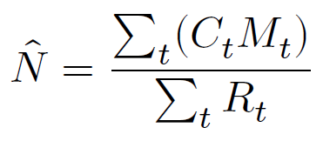
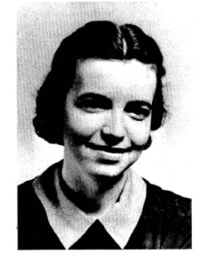
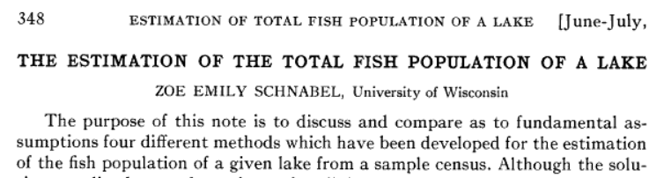
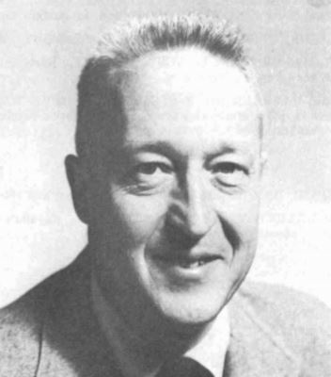
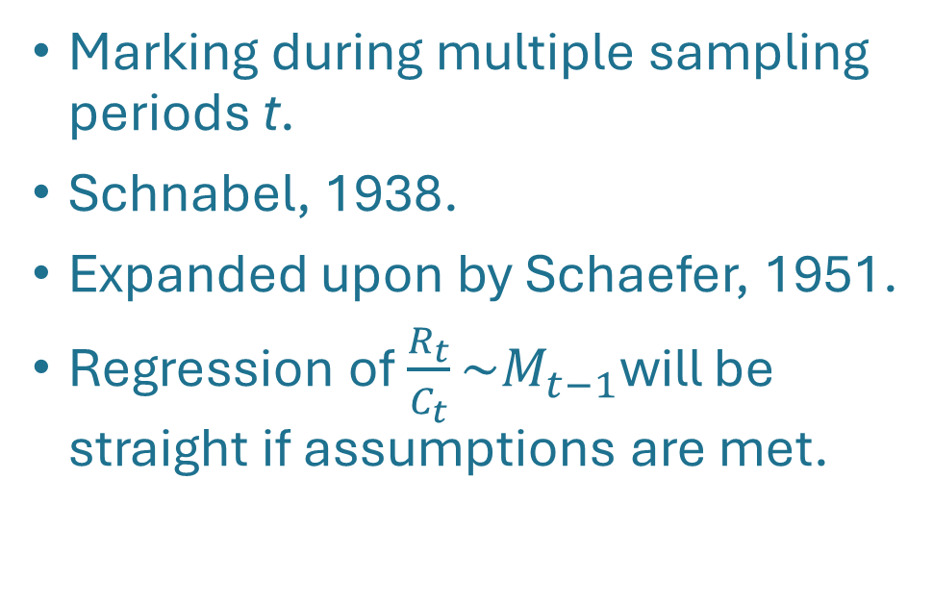
MR: Schnabel estimator
Marking during multiple sampling periods t.
Schnabel, 1938.
Expanded upon by Schaefer, 1951.
Regression of $\frac{R_{t}}{C_{t}}\sim M_{t−1}$will be straight if assumptions are met.
Photo: unattributed
Photo: unattributed
Schnabel, Zoe E. 1938. “The estimation of the total fish population of a lake.” Am. Math. Monthly, vol. 45. pp. 348-352.
Schaefer, M. B. 1951. “Estimation of the size of animal populations by marking experiments.” U.S. Fish and Wildlife Service Fisheries Bulletin 69:191 – 203.
Notes:
In the ’30s the Lincoln-Petersen estimate was updated by Zoe Emily Schnabel (and later expanded upon by Milner Schaefer in 1951), into what's known as a Schnabel estimator. This method allow for multiple series of capture/recapture periods used as a series of Lincoln-Peterson estimates, which allowed for more accurate estimates of abundance using a more intense field survey method.

Slide 13
MR: assumptions
Population is constant (closed): no birth, death, or migration.
Probability of capture is equal across all individuals.
Marked fish reintegrate into the population.
Fish do not lose marks.
How can violations of these assumptions impact bias in our abundance estimate?
Notes:
Of course, whenever we are talking about creating a model of a population, or estimating a population, we have to make assumptions about the real world to translate into our model. The LP and Schnabel estimates had the following assumptions

Slide 14
How CVCS violates MR assumptions
Population is constant (closed): no birth, death, or migration.
Carcasses are “birthed” and enter the system un-marked.
Carcasses can degrade or be flushed out of the system with out being accounted for.
Probability of capture is equal across all individuals.
Probabilities of capture and survival could differ based on carcass or environmental variables.
Notes:
As most of your probably know, our survey populations violate several of those assumptions, and not in insignificant ways. We know that in our carcass surveys, new carcasses are being added to the system over the course of the survey, as well as being removed before or after detection through a variety of methods. Also we can assume that there are a variety of factors that can cause some carcasses to be more likely to be captured or recaptured than other carcasses, factors that are attributed to the carcass (such as size), or environmental factors such as flow or turbidity.

Slide 15
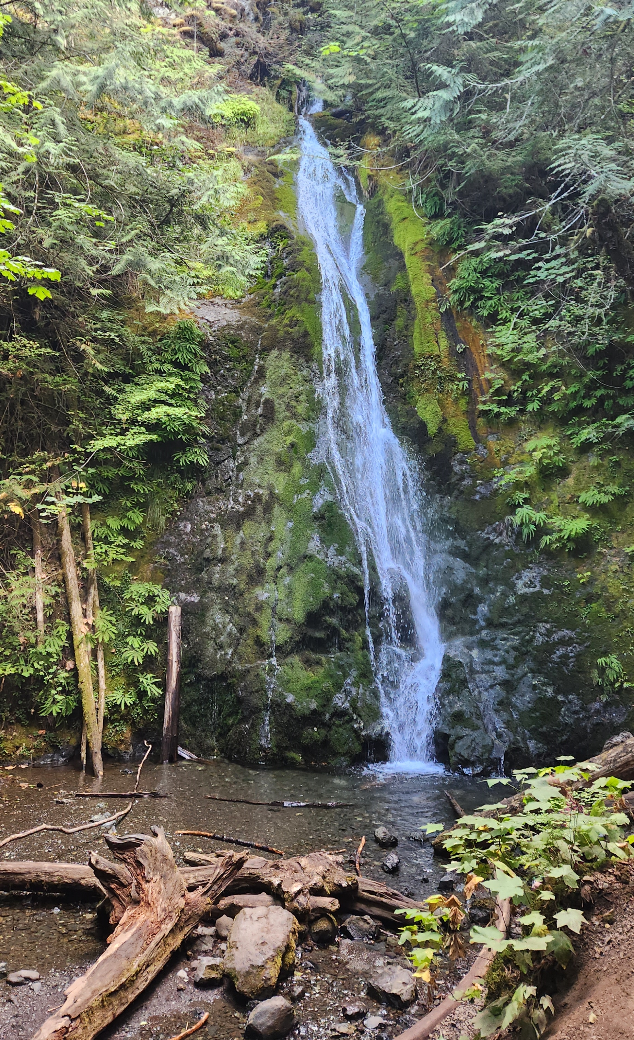
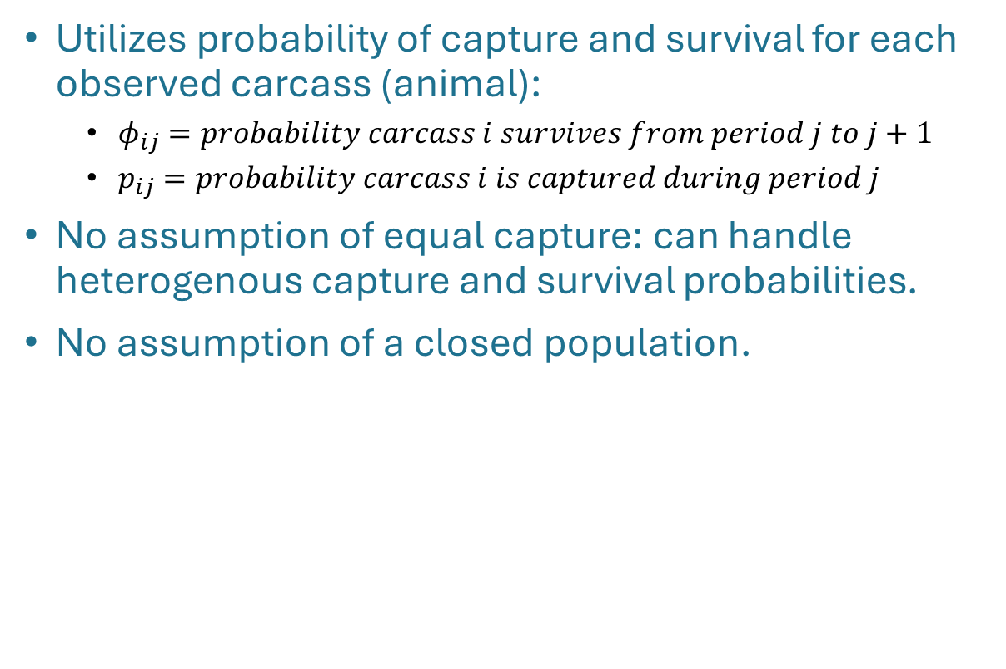
The Cormack-Jolly-Seber (CJS) model
Utilizes probability of capture and survival for each observed carcass (animal):
${\text{φ}}_{ij}=probability carcass i survives from period j to j+1$
$p_{ij}=probability carcass i is captured during period j$
No assumption of equal capture: can handle heterogenous capture and survival probabilities.
No assumption of a closed population.
Schwarz, C. J., R. E. Bailey, J. R. Irvine, and F. C. Dalziel. 1993. Estimating spawning escapement using capture-recapture methods. Can. J. Fish. Aquat. Sci. Vol 50:1181-1197.
Cormack, R. M. 1964. Estimates of survival from the sightings of marked animals. Biometrika 51:429 – 438.
Notes:
This brings us to our current method of estimating abundance using carcass mark-recapture surveys, known as the Superpopulation model. This utilizes the Cormack-Jolly-Seber model to estimate the probability of survival and capture of each fish. We then utilize these estimates of probability to calculate the number of births, or new carcasses entering the system, for each survey period, which will then give an overall estimate of abundance. It’s important to note that this method does not assume equal capture probabilities for all carcasses and does not assume a closed population.

Slide 16
The Cormack-Jolly-Seber assumptions
Tagged fish are representative of the population.
Number of released fish is known.
Tagging is accuracy with no tag loss.
Time interval between recapture periods is brief relative to life-history.
Notes:
This brings us to our current method of estimating abundance using carcass mark-recapture surveys, known as the Superpopulation model. This utilizes the Cormack-Jolly-Seber model to estimate the probability of survival and capture of each fish. We then utilize these estimates of probability to calculate the number of births, or new carcasses entering the system, for each survey period, which will then give an overall estimate of abundance. It’s important to note that this method does not assume equal capture probabilities for all carcasses and does not assume a closed population.

Slide 17
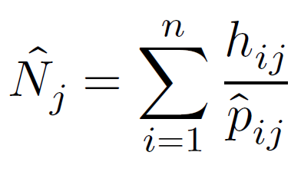
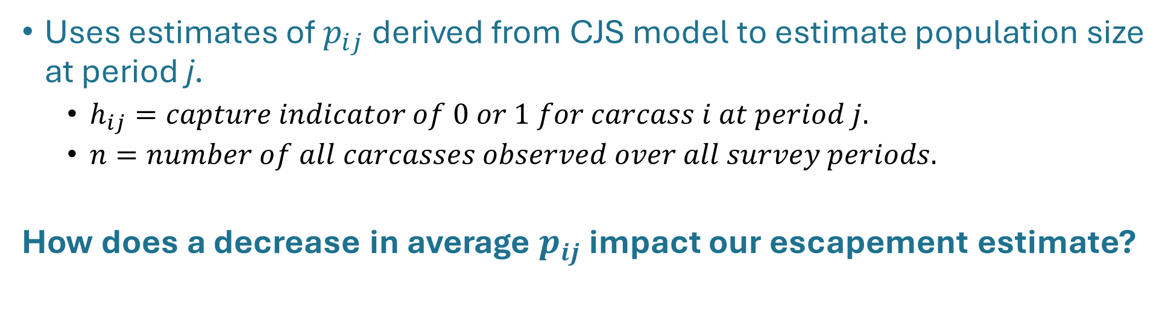
Horvitz-Thompson estimator
Uses estimates of $p_{ij}$ derived from CJS model to estimate population size at period j.
$h_{ij}=capture indicator of 0 or 1 for carcass i at period j.$
$n=number of all carcasses observed over all survey periods.$
How does a decrease in average $p_{ij}$ impact our escapement estimate?
D.G. Horvitz and D.J. Thompson. “A Generalization of Sampling Without Replacement From a Finite Universe”. In: Journal of the American Statistical Association 44.260 (1952), pp. 663–685. issn: 00283932. url: http://www.ncbi.nlm.nih.gov/pubmed/16243365.
J.D. Nichols. Modern Open-Population Capture-Recapture Models. Ed. by Steven C. Amstrup, Trent L. McDonald, and Bryan F.J. Manly. Princeton Univ. Press, 2008, pp. 88–123.
Notes:
Basically it’s saying the abundance of carcasses at time 𝑗 is equal to the sum of all the carcasses captured during that period divided by their capture probability.

Slide 18
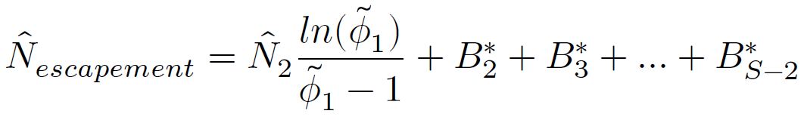
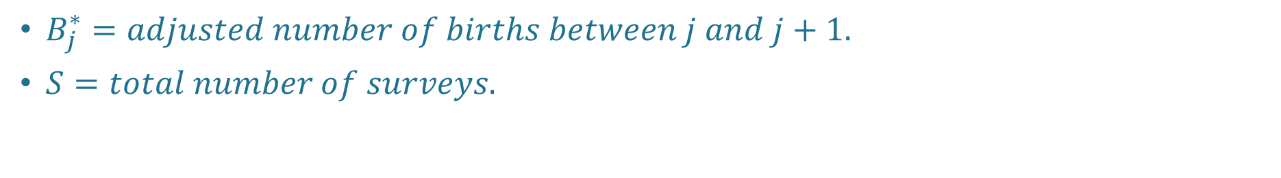
The super population modification
$B_{j}^{∗}=adjusted number of births between j and j+1.$
$S=total number of surveys.$
Bergman, J. M., Nielson, R. M., & Low, A. (2013). CENTRAL VALLEY CHINOOK SALMON IN-RIVER ESCAPEMENT MONITORING PLAN. Paper Knowledge . Toward a Media History of Documents, 12–26.
Notes:
Typically the total population estimate 𝑁̂ is calculated by taking the average value of 𝑁𝑗̂ , however there are problems with this method when many individuals are entering and leaving the population during the survey. This can be improved by using a superpopulation modification to estimate total escapement

Slide 19
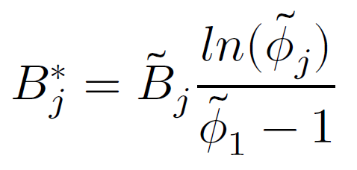
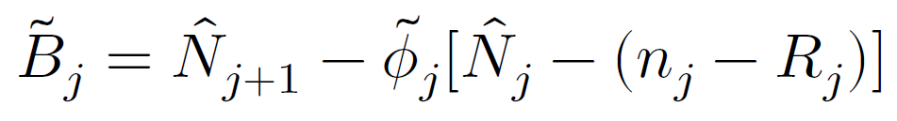
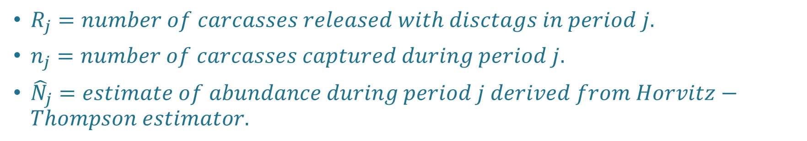
The super population modification
${\tilde{B}}_{j}=total births for period j.$
$R_{j}=number of carcasses released with disctags in period j.$
$n_{j}=number of carcasses captured during period j.$
${\hat{N}}_{j}=estimate of abundance during period j derived from Horvitz−Thompson estimator.$

Slide 20
The super population modification
How does an increase in average $\text{φ}$impact our escapement estimate?
Notes:
As phi increases towards 1, B_tilde will decrease. B_star will also decrease. Results in overall decrease of total escapement.
We can run into an interesting problem with this population modification method which I’ve actually seen in a real world example, where if the survival and capture probabilities are high enough, and our N_hat estimates are low enough, we can end up with a total escapement estimate that is less than the total number of carcasses we observed.

Slide 21
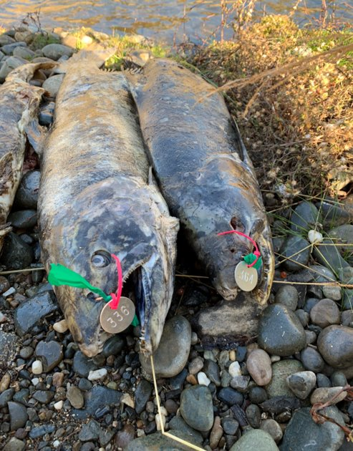
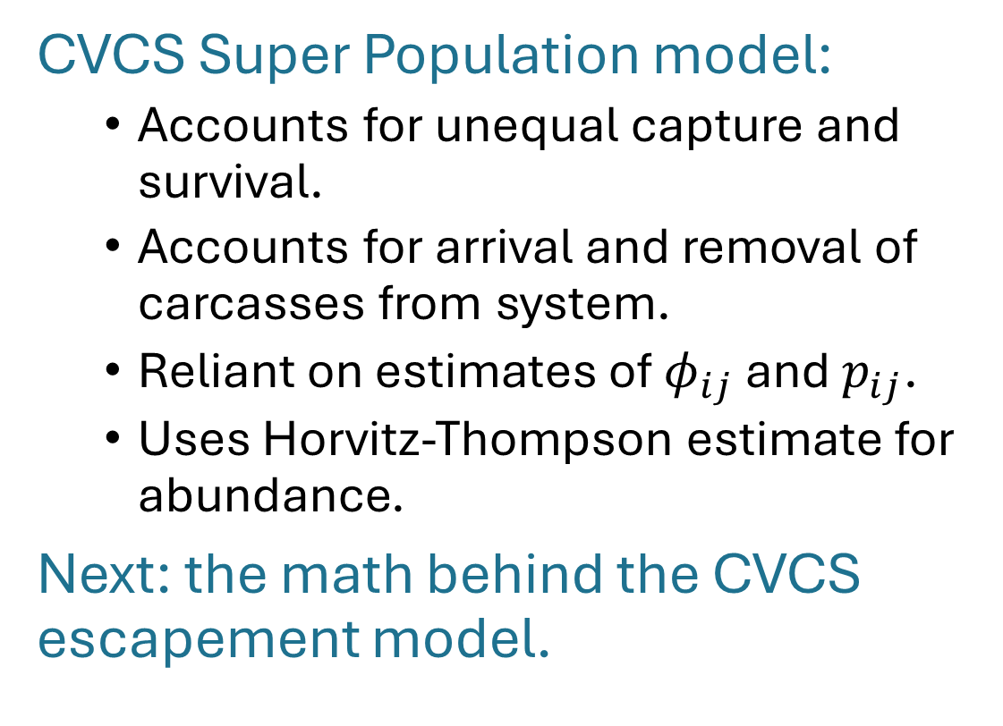
Wrap up
CVCS Super Population model:
Accounts for unequal capture and survival.
Accounts for arrival and removal of carcasses from system.
Reliant on estimates of ${\text{φ}}_{ij}$ and $p_{ij}$.
Uses Horvitz-Thompson estimate for abundance.
Next: the math behind the CVCS escapement model.
Photo attribution: Tracy Grimes

